Slide 1
Introduction to INTERNET OF THINGS

Slide 2


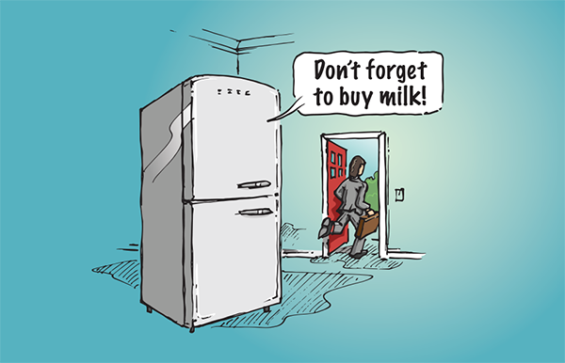
What is IoT?

Slide 3
Smart?

Slide 4
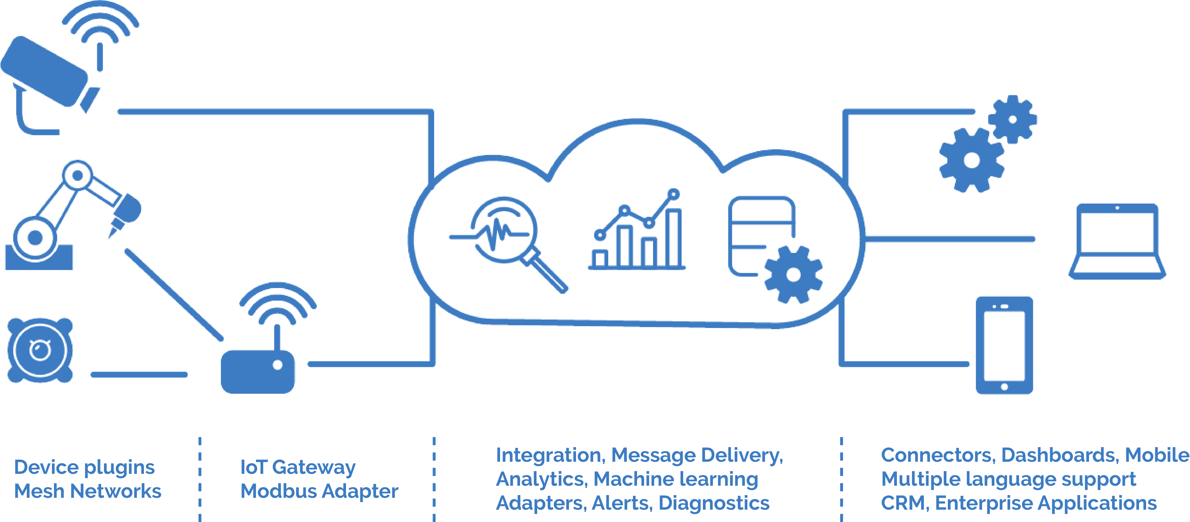
How It Works
Sensors/Devices
Gateway
Cloud Storage
Remote/Cloud Processing
Response/User Interface

Slide 5
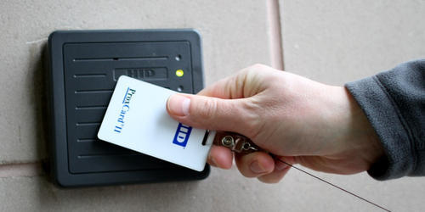
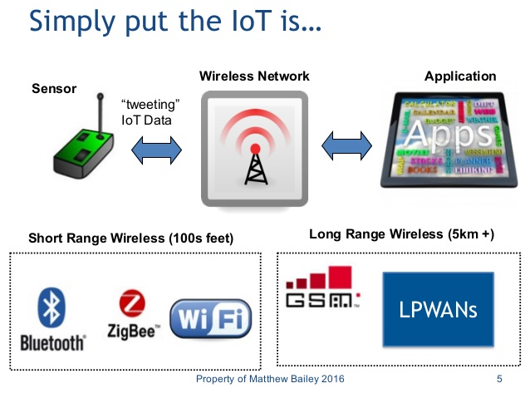
IoT Enabling Technologies
Addressability
(RFID, UID)
Short Range Wireless
(Bluetooth, Wi-Fi, Li-Fi, ZigBee)
Medium Range Wireless
(LTE Advanced, Halow)
Long Range Wireless
(LPWAN, VSAT)
Wired
(Ethernet, PLC)

Slide 6
IoT protocols
HTTP(Hyper Text Transfer Protocol)
MQTT(Message Queue Telemetry Protocol)
XMPP(Extensible Message Presence Protocol)
REST(Representational State Transfer)
COAP(Constraint Application Protocol)

Slide 7

Bored are we? Lets start working!!!!

Slide 8
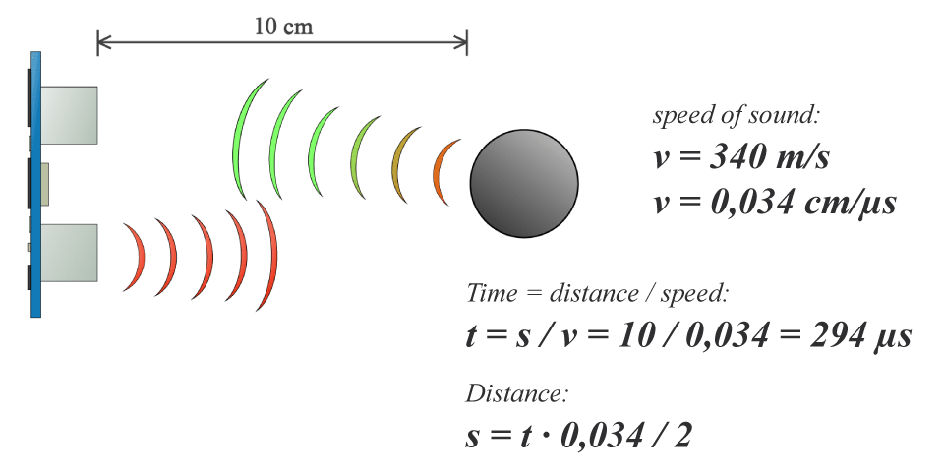
Operating with Sensors(In This Case Ultrasonic Sensor)

Slide 9
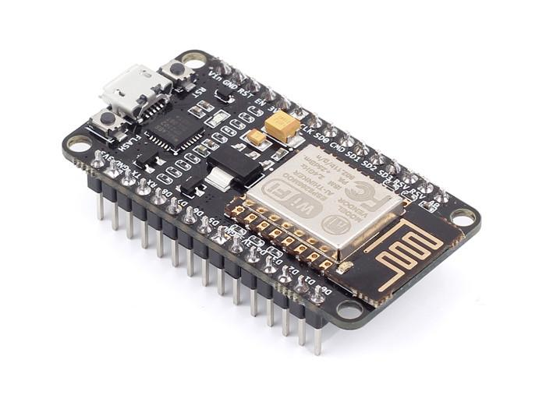
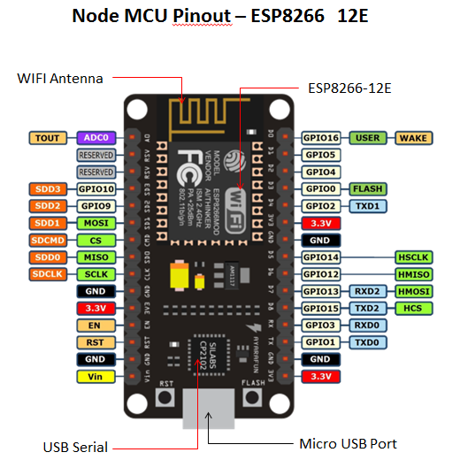
NodeMCU

Slide 10
Libraries
Link
http://arduino.esp8266.com/stable/package_esp8266com_index.json
Package
Tools > Board > Board Manager > Search “esp8266” > Install

Slide 11
HyperText Transfer Protocol
HTTP Request
HTTP Response
Header
HTTP Server
GET & POST

Slide 12
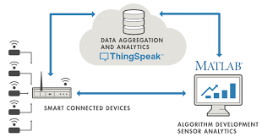
Data Visualisation

Slide 13
HOW to ?
Open ThingSpeak Account
Create Channel
Enter Details in Field Section and Save Channel
Go to API Keys Tab
Copy and Paste the API Key on to the code.

Slide 14
What is an API ? How to use an API Key?
An API is a set of functions and procedures that allow the creation of applications which access the features or data of an operating system, application, or other service.
The API key often acts as both a unique identifier and a secret token for authentication, and will generally have a set of access rights on the API associated with it. API keys can be based on the universally unique identifier (UUID) system to ensure they will be unique to each user.

Slide 15
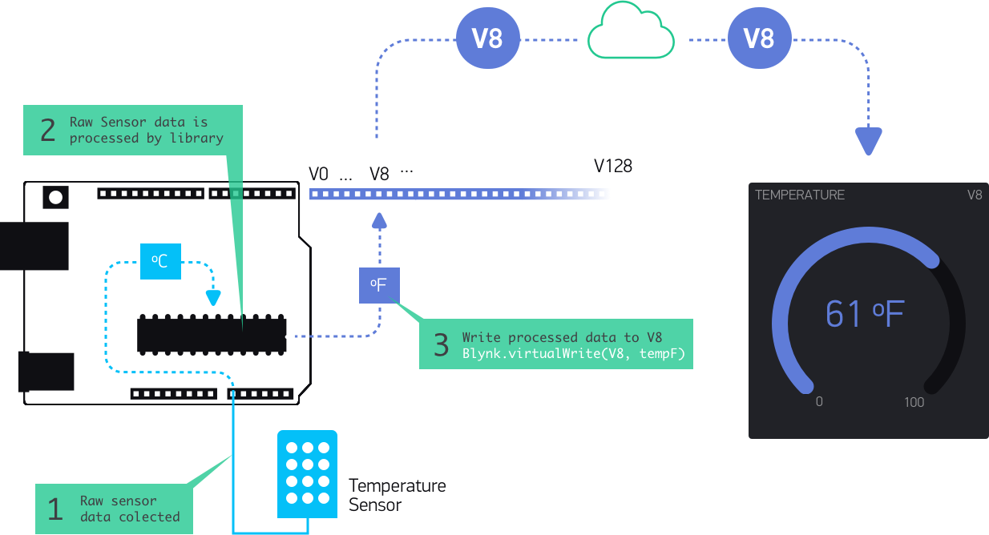
What is Blynk? How it works?

Slide 16
Applications of IoT
Smart Homes (Ex. Nest, ecobee, etc.)
Automobile Industry (Ex. BMW Open Mobility Cloud)
Wearables (Ex. Apple Smart Watch)
Agriculture and Livestock (Ex. Fujitsu Connected Cow)
Smart City and Energy Management (Ex. Huawei NOS)
Smart Retail (Ex. Amazon Go – Smart Shopping Experience)

Slide 17
Final PRoject
Problems Statement:
Build a Smart Home Application which can trigger the home lighting (ON/OFF)
when someone enters or exits respectively and notify on smartphone.
Hardware Provided:
NodeMCU/Arduino UNO, Ultrasonic Sensor(HC-SR04), Relay/LED, Jumper Cables and Breadboard.
Software Provided:
Arduino IDE, Blynk App

